Slide 1

COMPUTER NETWORKS
Sivaraman Eswaran Ph.D.
Department of Computer Science and Engineering

Slide 2

COMPUTER NETWORKS
Computer Networks and the Internet
Sivaraman Eswaran Ph.D.
Department of Computer Science and Engineering

Slide 3
COMPUTER NETWORKS
“Protocol Layers” and reference models
Networks are complex,
with many “pieces”:
hosts
routers
links of various media
applications
protocols
hardware, software
Question:
is there any hope of organizing structure of network?
…. or at least our discussion of networks?

Slide 4
COMPUTER NETWORKS
Example: Organization of Air Travel
ticket (purchase)
baggage (check)
gates (load)
runway takeoff
airplane routing
ticket (complain)
baggage (claim)
gates (unload)
runway landing
airplane routing
airplane routing
airline travel: a series of steps, involving many services

Slide 5
COMPUTER NETWORKS
Layering of Airline functionality
ticket (purchase)
baggage (check)
gates (load)
runway takeoff
airplane routing
ticketing service
ticket (complain)
baggage (claim)
gates (unload)
runway landing
airplane routing
baggage service
gate service
runway service
routing service
airplane routing
layers: each layer implements a service
via its own internal-layer actions
relying on services provided by layer below
Q: describe in words the service provided in each layer above

Slide 6
COMPUTER NETWORKS
Why layering?
dealing with complex systems:
explicit structure allows identification, relationship of complex system’s pieces
layered reference model for discussion
modularization eases maintenance, updating of system
change in layer's service implementation: transparent to rest of system
e.g., change in gate procedure doesn’t affect rest of system
layering considered harmful?
layering in other complex systems?

Slide 7
COMPUTER NETWORKS
Internet Protocol Stack
application: supporting network applications (access to network resources)
IMAP, SMTP, HTTP
transport: process-process data transfer (segmentation & reassembly, sockets, connection, flow and error control)
TCP, UDP
network: routing of datagrams from source to destination (addressing, routing)
IP, routing protocols
link: data transfer between neighboring network elements (framing, addressing, flow & error control)
Ethernet, 802.11 (WiFi), PPP
physical: bits “on the wire”
application
transport
network
link
physical

Slide 8

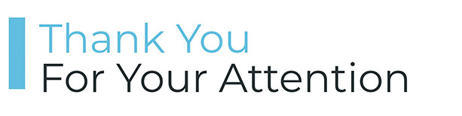
COMPUTER NETWORKS
Queries

Slide 9
THANK YOU
Sivaraman Eswaran Ph.D.
Department of Computer Science and Engineering
sivaramane@pes.edu
+91 80 6666 3333 Extn 834

